Slide 1
DATA SCIENCE Personal Veihcle Imports
Aviv Ashtamker
Bar Salem

Slide 2
Research Intro:
Motivation:
We wanted to know whether if vehicle is being imported new or used, and if can we predict with the the production year with machine learning algorithms' using linear regression.
Research questions:
Can we predict the Production year of specific vehicle?
Can we predict the “Brand” of the vehicle?

Slide 3
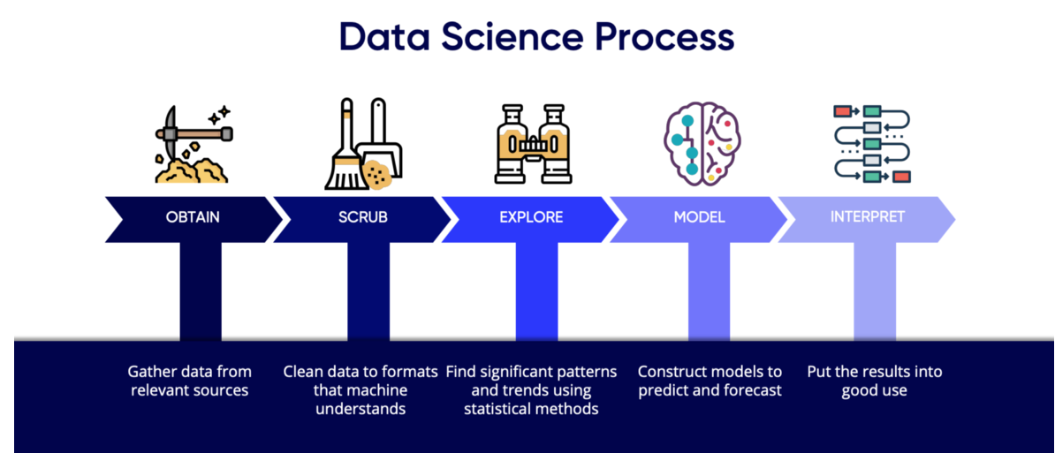
Our Project process:
TARGET

Slide 4
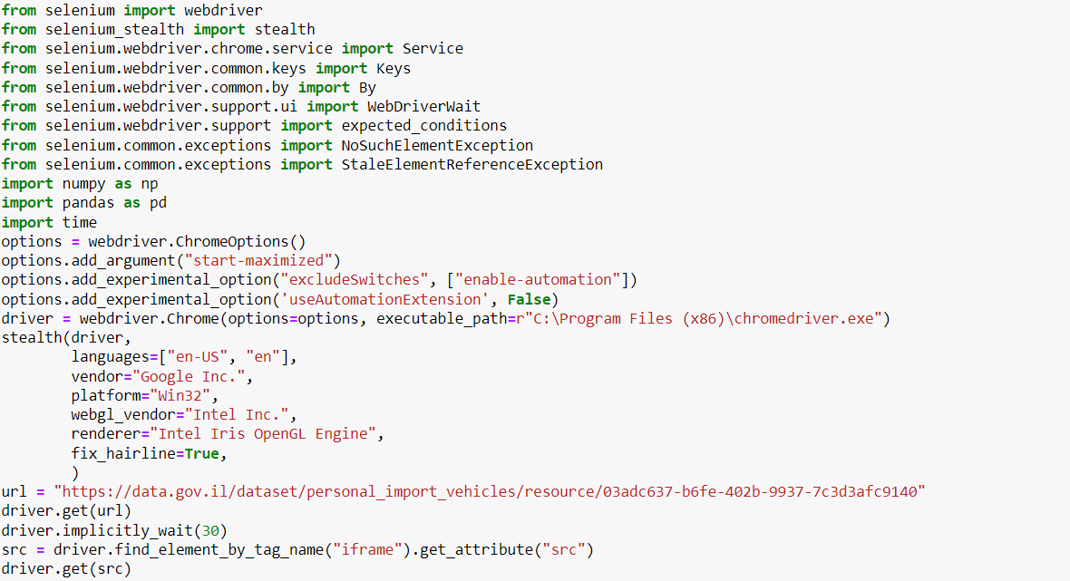
Data Sources:
We scraped our data using selenium library from:
Government’s Data

Slide 5

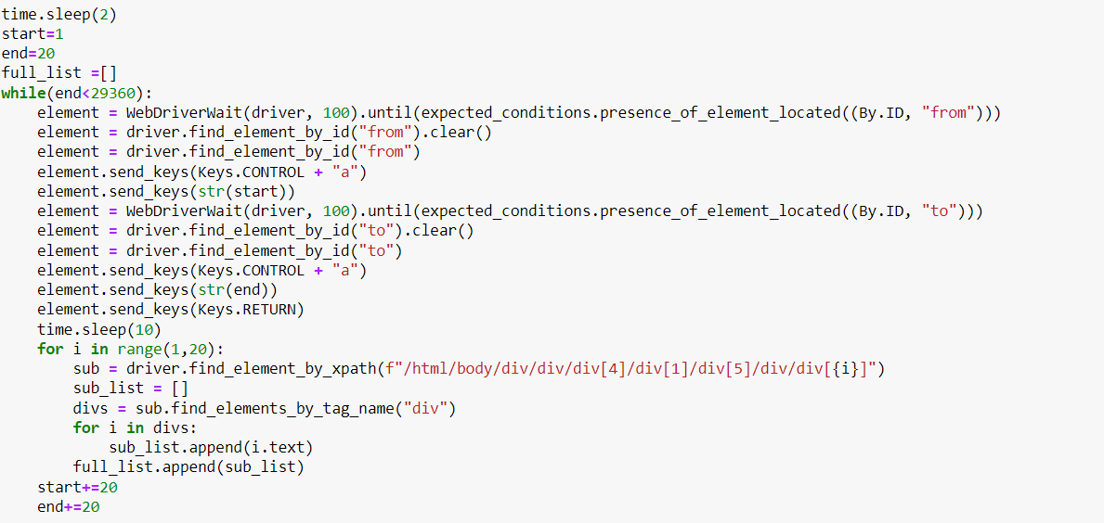
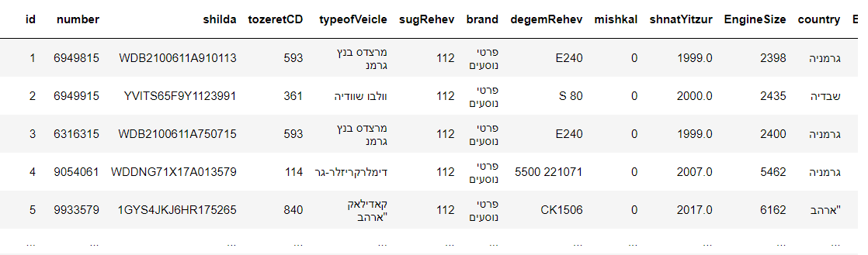
Crawling Code:

Slide 6
Crawling Difficulties:
During the crawling stage, we had our fair share of difficulties. At first as we built our crawler and tried to run it the website blocked us, we got over it thanks to “selenium-stealth” library.
As we tried to get our data from the site we noticed that the data was dynamic and changes on every scrolling down of the page . After we built our crawler and started to pull data we noticed that html objects didn’t succussed to load ,so we had to stop our driver every time. Then we run it for the whole night and because after the whole night we got a dataset of about 19,000 rows and 14 columns, which became our data-frame.

Slide 7
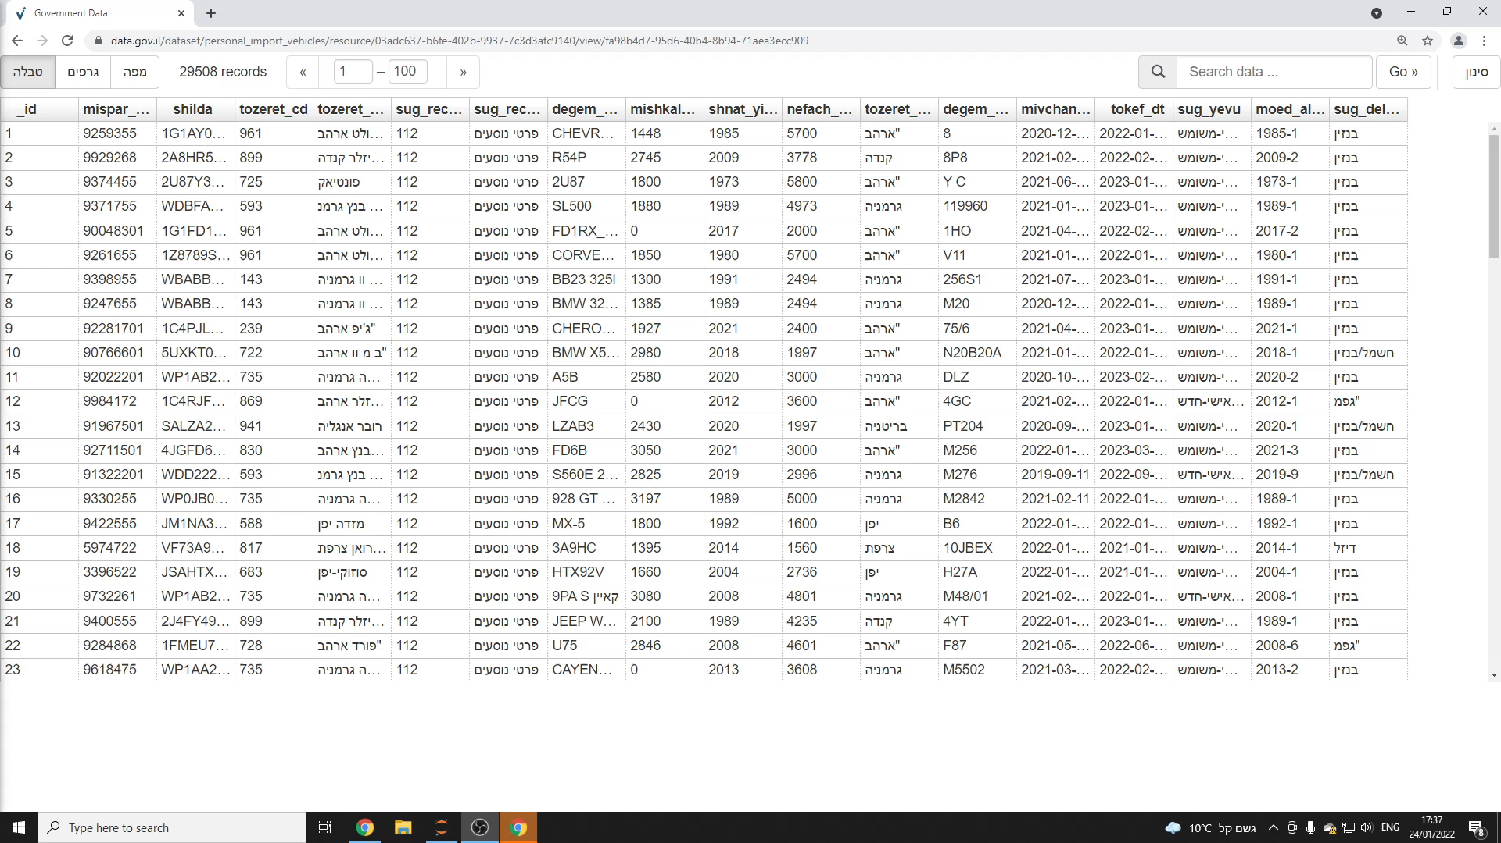
Selenium Crawling Demonstration:

Slide 8

Our Data Cleaning:
Most of the data was strings. We had to move all our data to numeric values, whether its Categorical variable like “Brand” or Measuring scale variable like “Production year”.
We had to clean the “Brand” values because same company had few names, for example (Mercedes , Mercedes Benz , Mercedes Benz).
We cleaned the dates from DD/MM/YYYY format to just numeric Year.
We continued by moving the engine size label to bins, by their relative distribution.

Slide 9
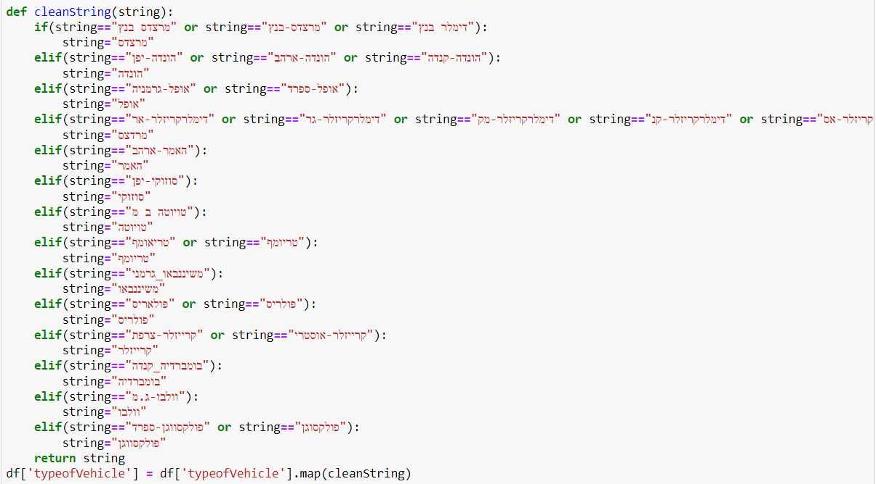
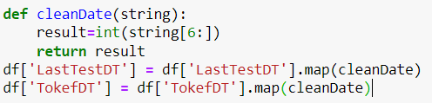

Slide 10
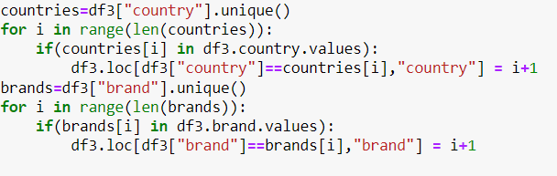
Move to numeric:

Slide 11
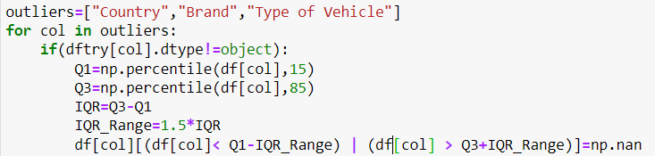
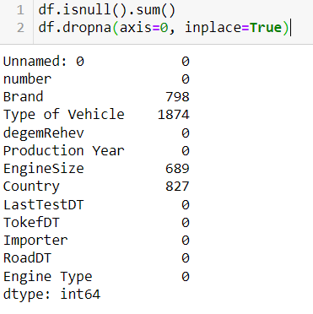
Removing outliers:
From:
~18000 rows X 14 columns
To:
~11500 rows X 12 columns

Slide 12
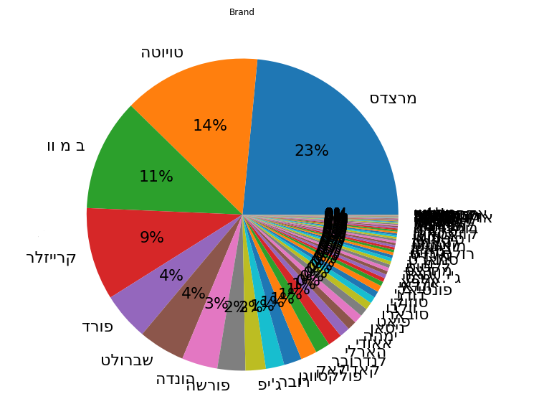
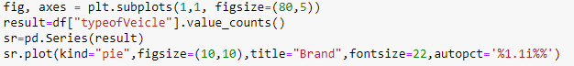
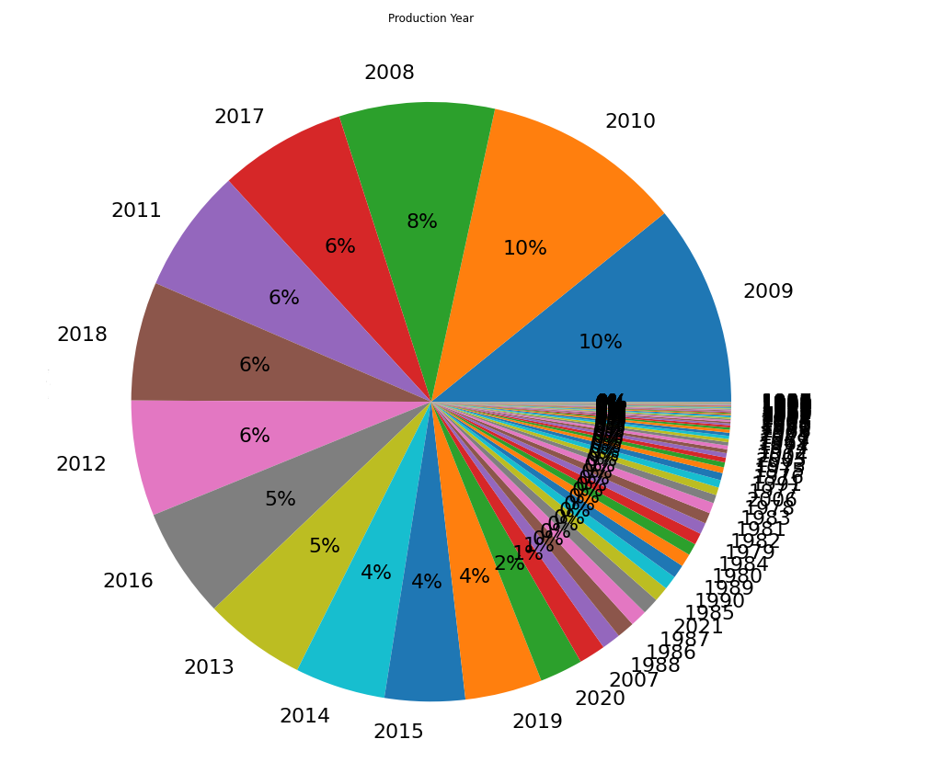
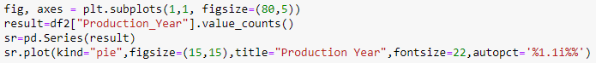
EDA and Distribution:

Slide 13
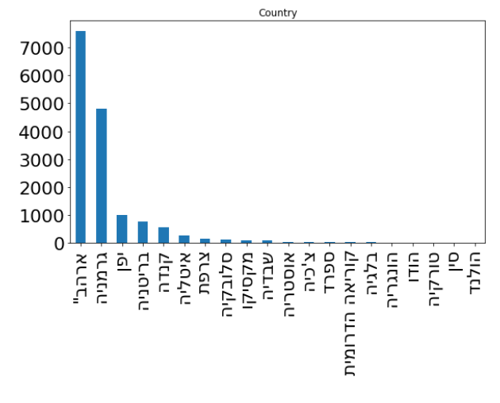
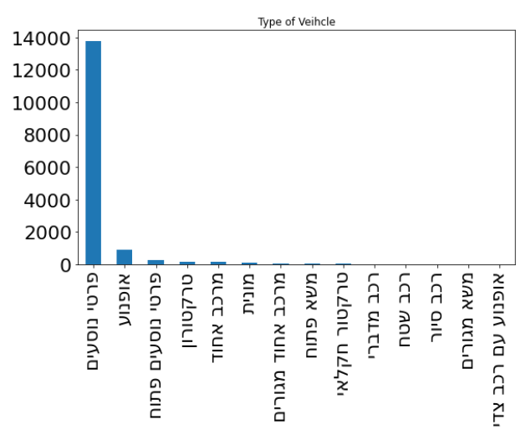
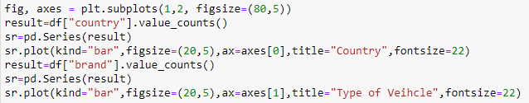
EDA and Distribution:
X Label- Names of the Countries.
Y Label- Appearance
X-Label-Type of personal import vehicles
Y-Label-Appearance

Slide 14
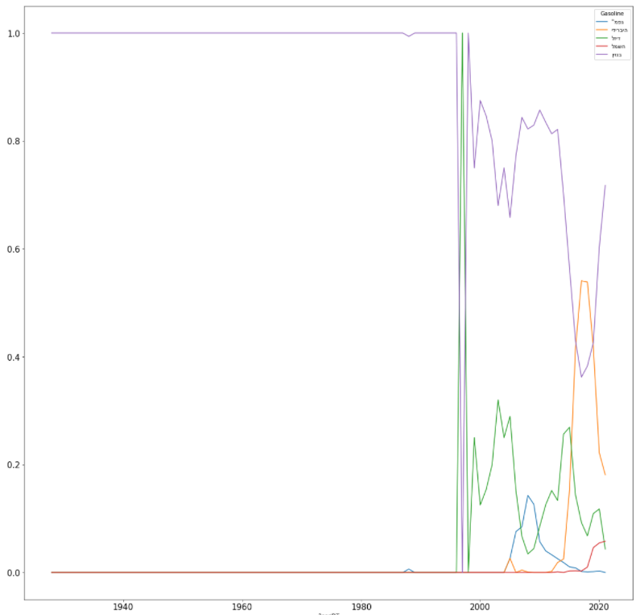
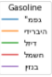
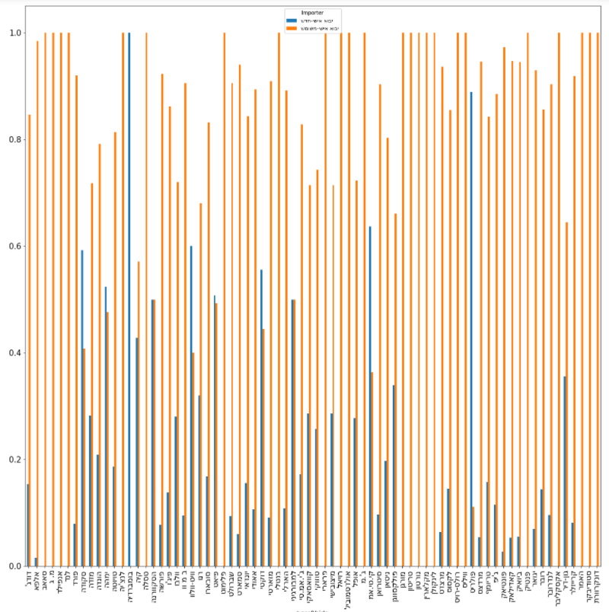
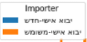

Slide 15
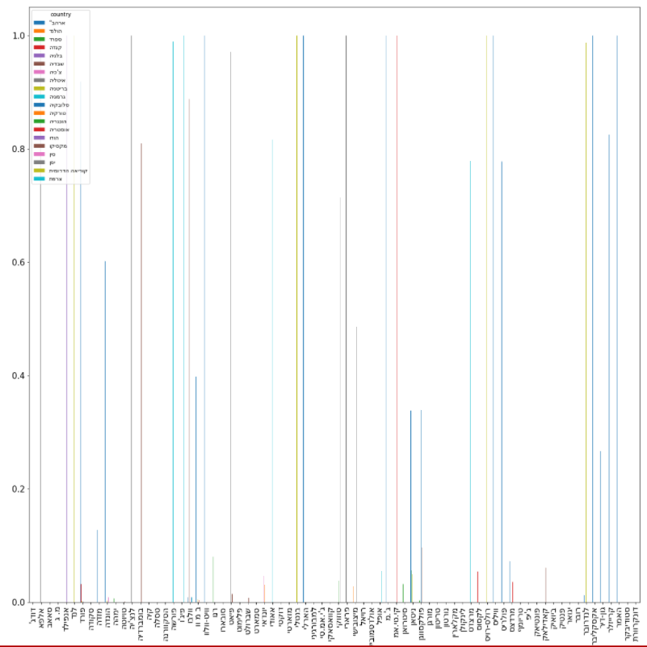
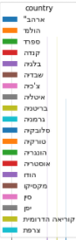

Slide 16
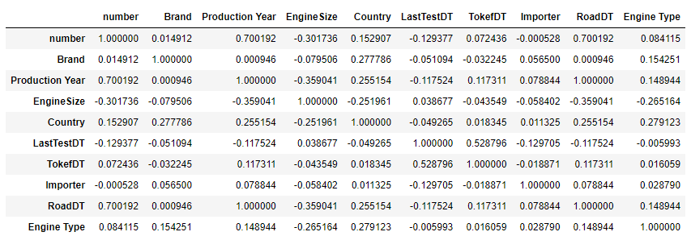
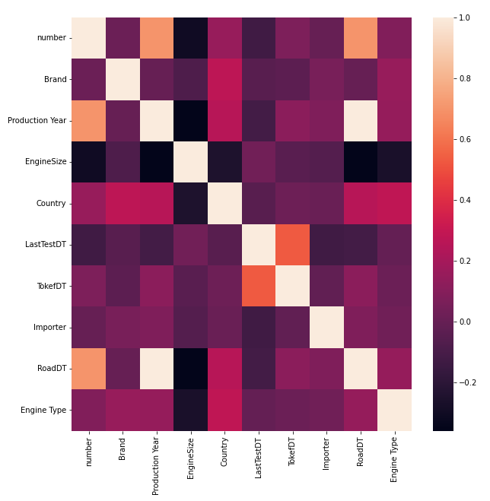
DataFrame Correlations:
This is all our labels' correlations, as we can see those are not so high.
First, we worried but finally we managed to get great result.

Slide 17

Machine Learning-Linear Regression

Slide 18
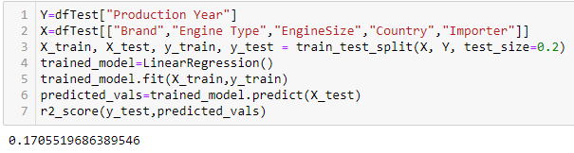
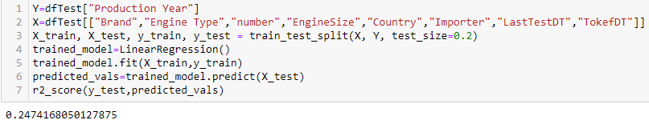
Machine Learning:
As we started to build our model we have failed more then a few times and got some pretty bad results (r2=0.01..- r2=0.05..), but we are two stubborn data scientists and after a few models and a lot of googling we got what is seems to be the best model to our linear regression problem.

Slide 19
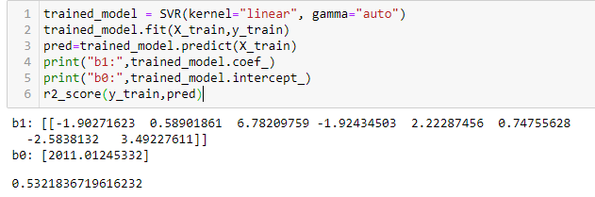
Machine Learning:
We tried also SVR linear regression, which didn’t help so much. The results were almost the same and even worse than sklearn linear regression.

Slide 20
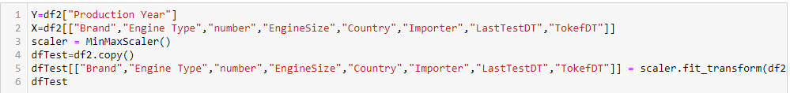
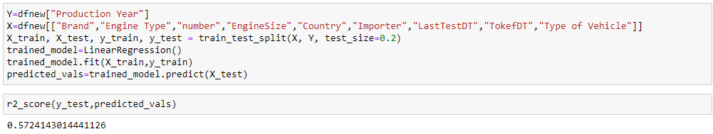
Machine Learning:
We had to clean the data more, to get more relevant and precise score,
Then finally we got R2 score which is greater than 0.5.

Slide 21
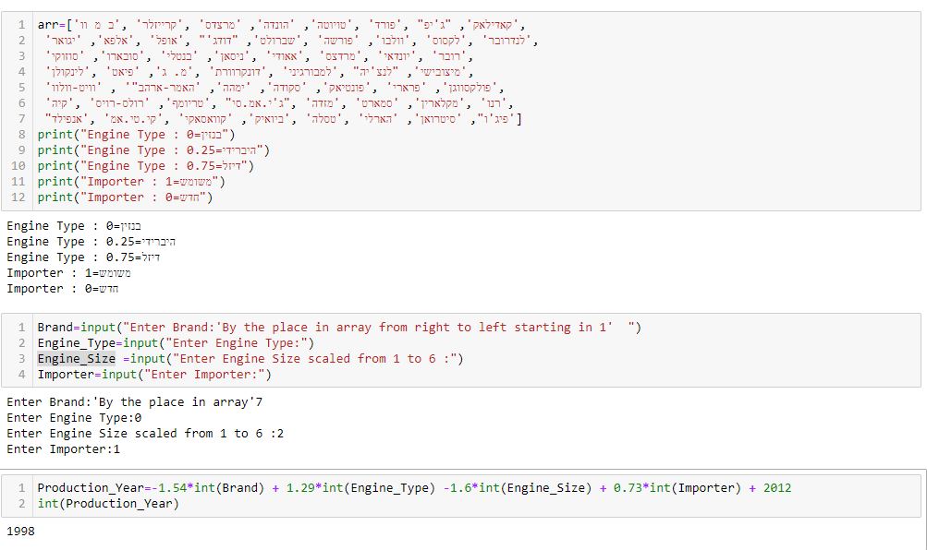
Linear Regression-Results:
Production Year=
-1.54x ”Brand” + 1.29x “Engine Type” + 6.34x “license number” -1.6x “Engine Size” +1.56x “country” + 0.73x”Importer”

Slide 22
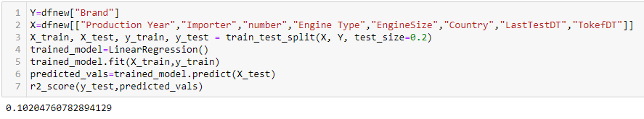
Machine Learning:
We also tried to vision brand of specific car with given parameters like “Production Year”, “Engine type” and more…
The result wasn’t so good at all, we assume it’s because most if the vehicles are used and not brand new.

Slide 23
Regression Conclusion’s:
Finally, when we had our ML results, we realized that it’s hard to vision the Production year of used vehicles, The reason is because there are not specific parameters for those cars, everyone orders what ever he wants.
If those vehicles were brand new, maybe we could have more correlation between parameters because there will be more connection between the parameters if it’s new car, and then we can have much better results.
For the continue
For this study persistence, We would like to invest what is the reason that make people order used cars and not brand new, using personal imports.

Slide 24
Thanks!!
Aviv Ashtamker,
Bar Salem
Do you have any questions?

